Slide 1

One huge problem
Ideas on an epidemic dynamics model

Slide 2
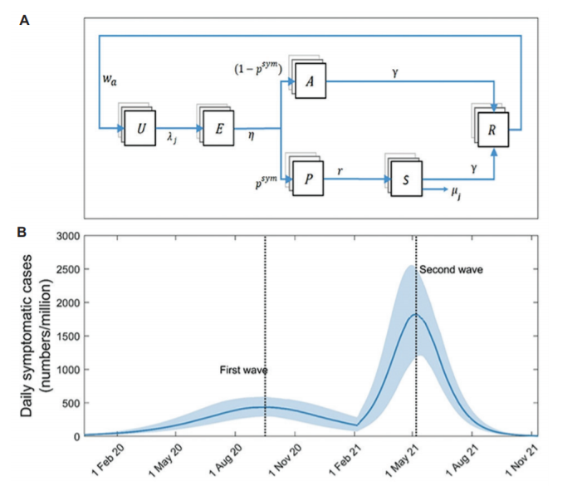
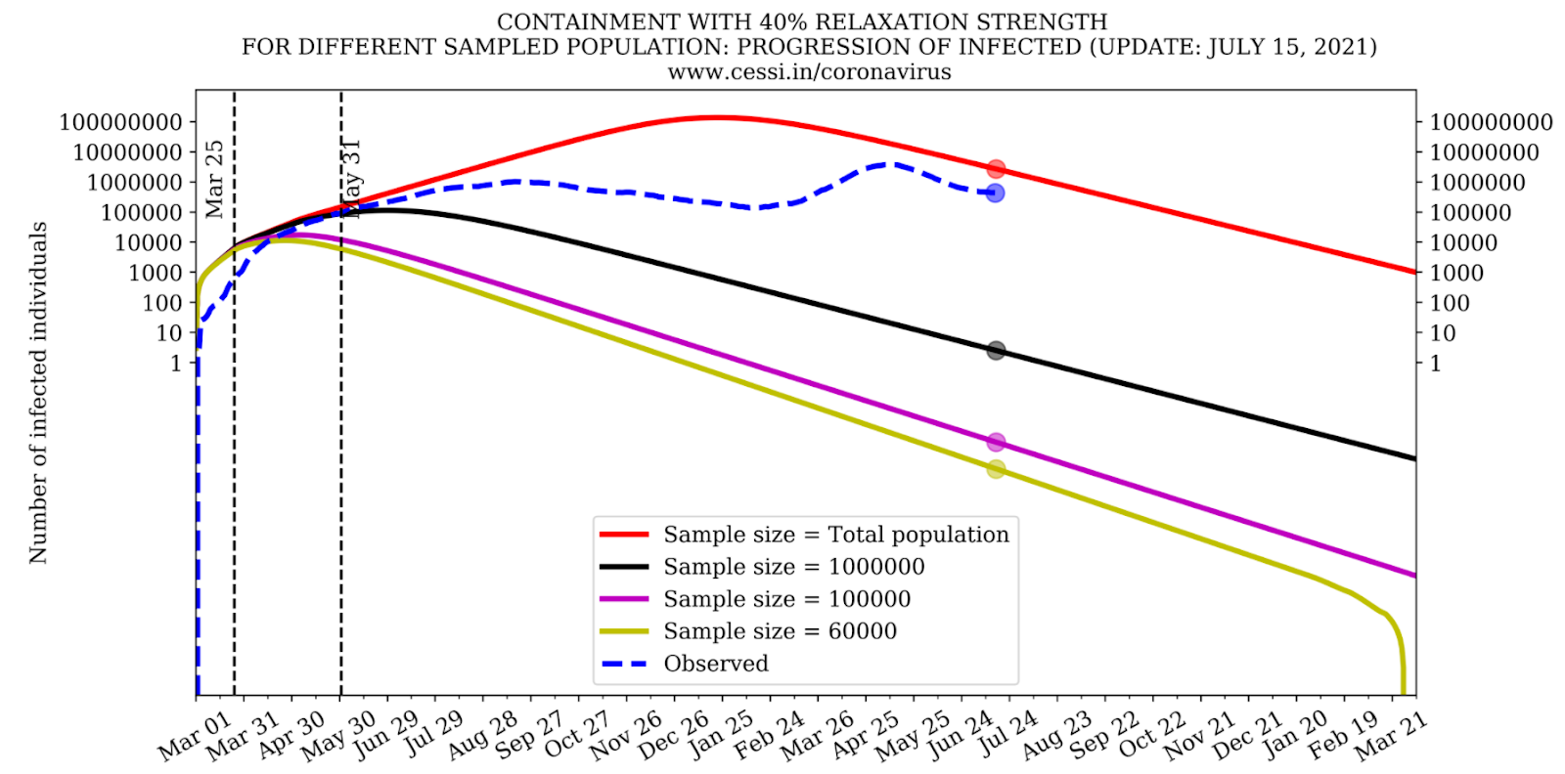

Motivation
SEIRD models don’t work
Modelled daily cases with time: ICMR.
Comparatively low cases per wave achieved by fixing R₀ values.
Active cases vs time at various containment strengths: CESSI
Notes:
As an example, let us look at two modifications of the SIR model. In the first one, Lockdowns with different relaxations are shown (describe). In the second one…
ICMR: Huge assumption that waves are primarily caused by different variants. Clearly a bad assumption as waves are observed even in bacterial epidemics like plague.

Slide 3
Questions
In some areas, it was seen that there was a relatively long area of pseudo linear increase in cases before a wave was triggered. What triggers a wave, and do some factors in this period of linearity affect this trigger. Is it some kind of an unstable equilibrium, and the waves inevitable?
What parameters exactly define the time window and intensity of a wave. A few parameters seem to be obvious, but are clearly either non-exhaustive or haven’t been understood enough yet. For example human behavior, mutation, etc.
When and how does a pandemic end? - Becomes an endemic virus (flu), or there are no infections at all (MERS). What factors result in this difference?
Can we get an idea of the infection undercounting in the data from a mathematical model?

Slide 4
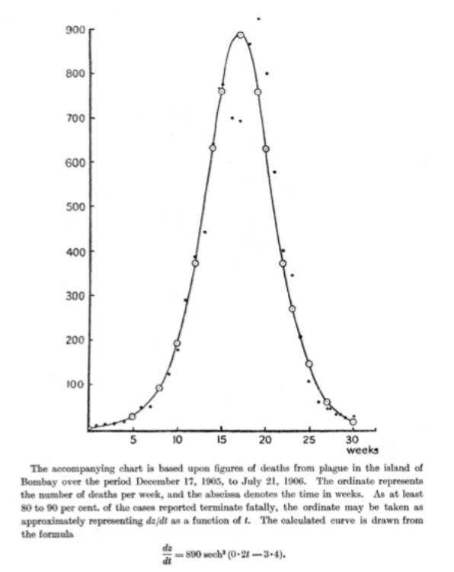
Would infection spread models work?
Let’s try to find out!
The SIR model seems to perform well for some localized infections. Why does it fail for others?
Let us think of a few factors that might cause this failure:
Population diffusion.
Fear of virus (privilege to stay home).
Inhomogeneity in population density.
Mutation and emergence of new active strains.
Medical intervention (Vaccination)
Non-medical intervention (Lockdowns, etc.)
Notes:
Probable reasons for failure of SIR and possible ways to incorporate these.
Population diffusion: Network models with hops.
Fear of virus: A separate quarantine block?
Inhomogeneity: Network with different pop densities.
Mutation: Using R_0 values for different variants explicitly?
Vaccination: Just kill S
Non-medical:

Slide 5
Spatial inhomogeneity, diffusion and hops
Lattice model
Discretize the space into a lattice ,with each lattice point denoting one spatial element.
Thus, each node has its own set of differential equations.
We can define separate infection coefficients for intra and inter nodal infections, to account for the mobility rate.
Long distance travel can be modelled using hops between nodes.
The master equation representing the entire population will be a sum over the individual nodal equations.
Notes:
Need to give citiation

Slide 6

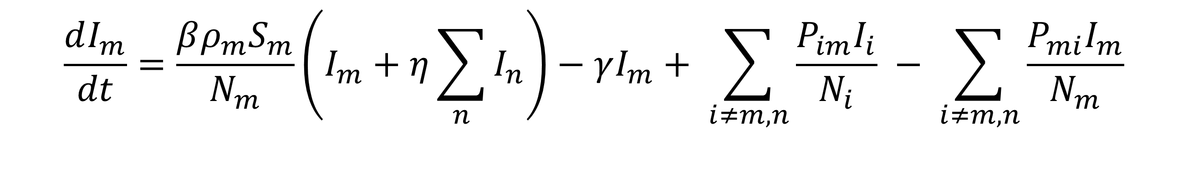
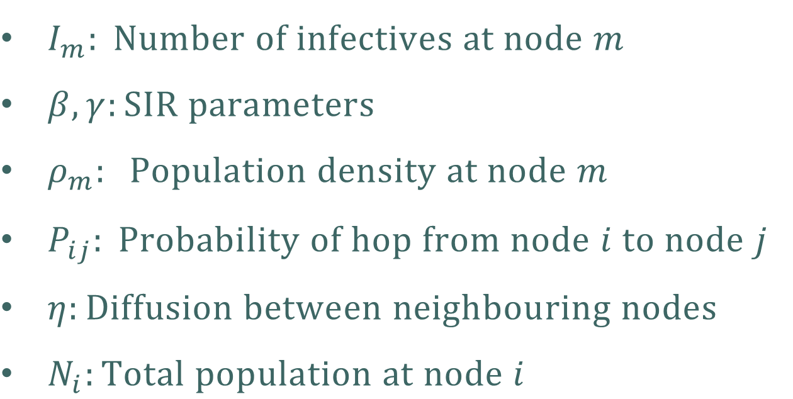
Lattice model
The equation
$$\frac{dI_{m}}{dt}=\frac{βρ_{m}S_{m}}{N_{m}}\left(I_{m}+η\sum_{n}{I_{n}}\right)−γI_{m}+ \sum_{i≠m,n}{\frac{{P_{im}I}_{i}}{N_{i}}} − \sum_{i≠m,n}{\frac{P_{mi}I_{m}}{N_{m}}}$$
$I_{m}: Number of infectives at node m$
$β,γ:SIR parameters$
$ρ_{m}: Population density at node m$
$P_{ij}: Probability of hop from node i to node j$
$η:Diffusion between neighbouring nodes$
$N_{i}:Total population at node i$
$Indices:$
$m$: current node
$n$ : Neighbours of m
Notes:
Need to give citiation

Slide 7
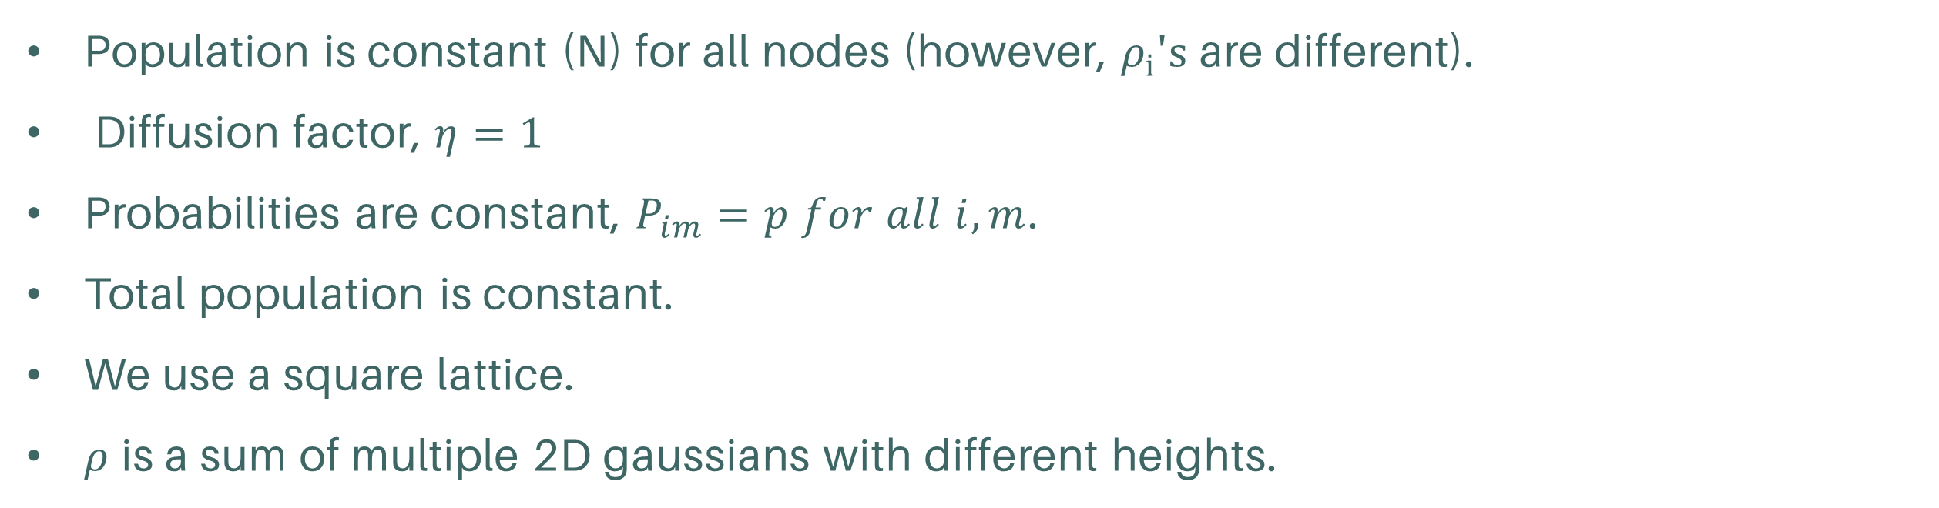
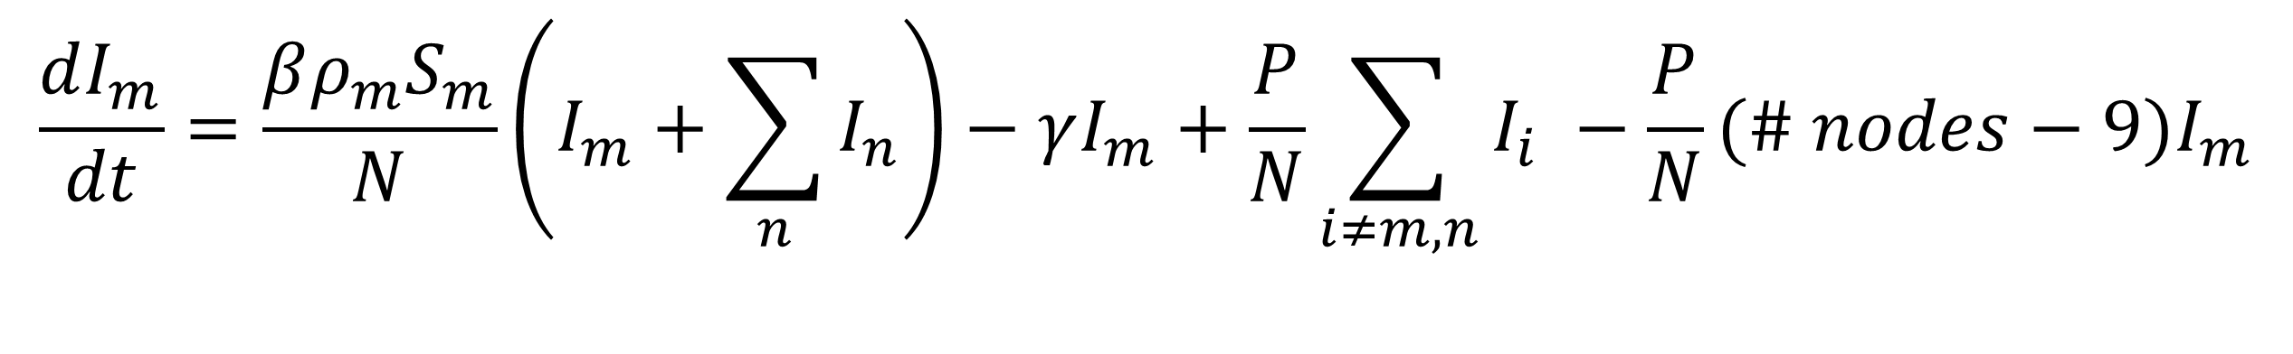
Lattice model
Some simplifications
Population is constant (N) for all nodes (however, $ρ_{i}′s$ are different).
Diffusion factor, $η=1$
Probabilities are constant, $P_{im}=p for all i, m$.
Total population is constant.
We use a square lattice.
$ρ$ is a sum of multiple 2D gaussians with different heights.
$$\frac{dI_{m}}{dt}=\frac{βρ_{m}S_{m}}{N}\left(I_{m}+\sum_{n}{I_{n}}\right)−γI_{m}+\frac{P}{N}\sum_{i≠m,n}{I_{i}} −\frac{P}{N}(\# nodes−9{)I}_{m}$$
Notes:
Need to give citiation

Slide 8
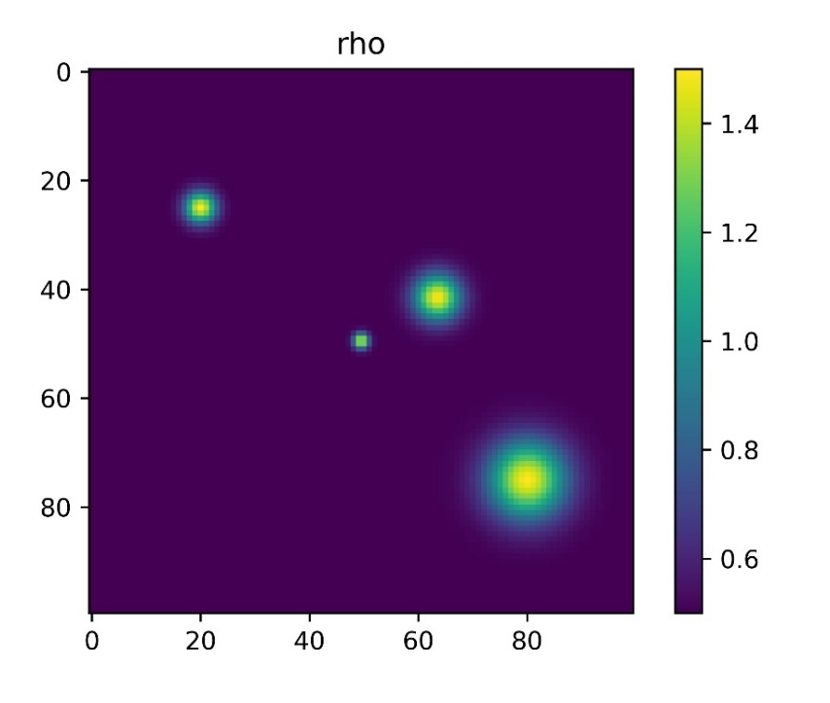
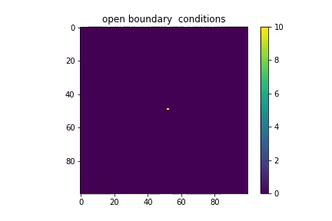
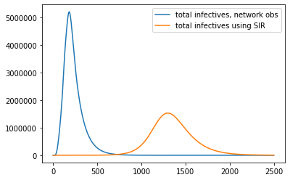
Lattice model
Preliminary result animations (Without hops)
Note: Lattices in the animation do not represent areas. They differ in their population densities
Notes:
Need to give citiation

Slide 9


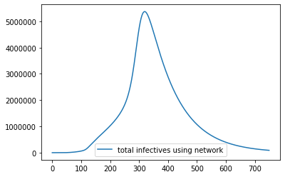
Lattice model
Preliminary result animations (With hops)
Note: Lattices in the animation do not represent areas. They differ in their population densities
Notes:
Need to give citiation

Slide 10
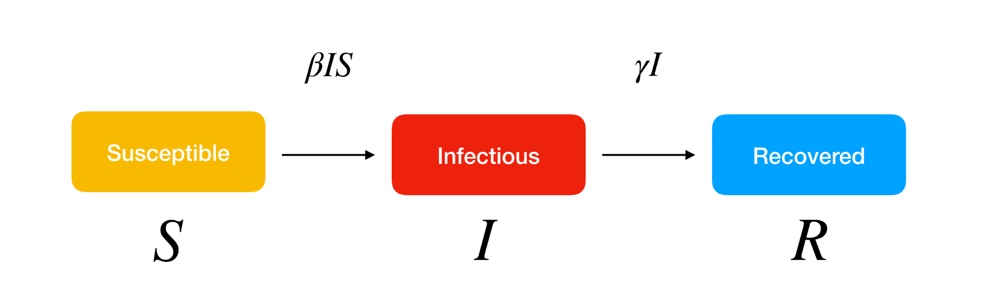
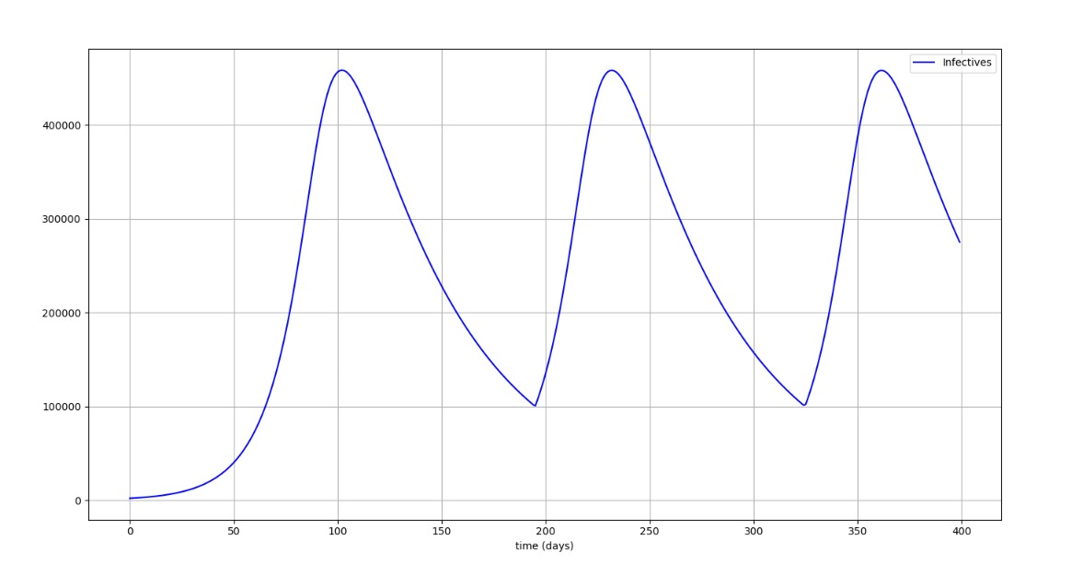

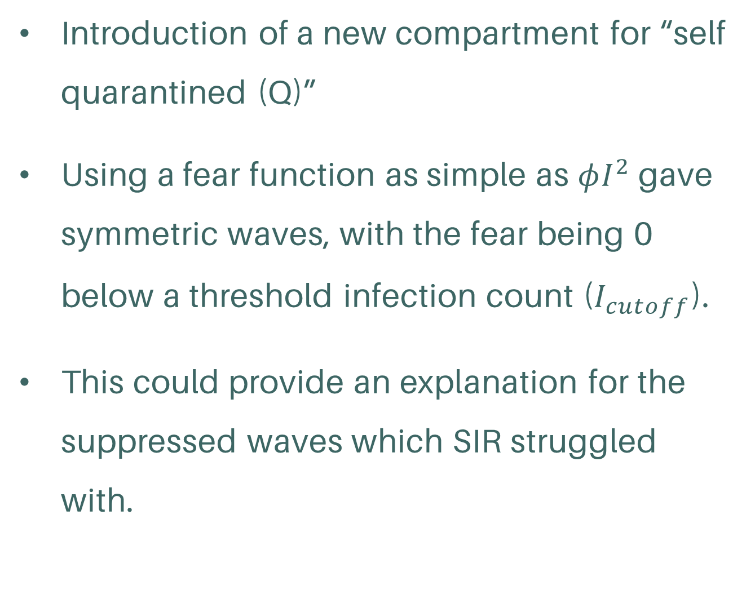
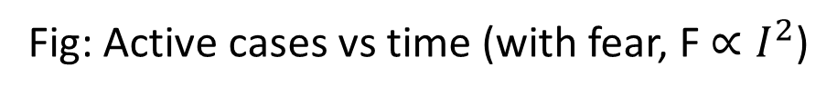
Lowering infection counts
An attempt at modelling fear
$$F(I, \frac{dI}{dt}, t).S$$
Introduction of a new compartment for “self quarantined (Q)”
Using a fear function as simple as $φI^{2}$ gave symmetric waves, with the fear being 0 below a threshold infection count ($I_{cutoff}$).
This could provide an explanation for the suppressed waves which SIR struggled with.
Quarantined
Q
Fig: Active cases vs time (with fear, F $∝I^{2}$)
Notes:
Huge assumption that waves are primarily caused by different variants. Clearly a bad assumption as waves are observed even in bacterial epidemics like plague.

Slide 11
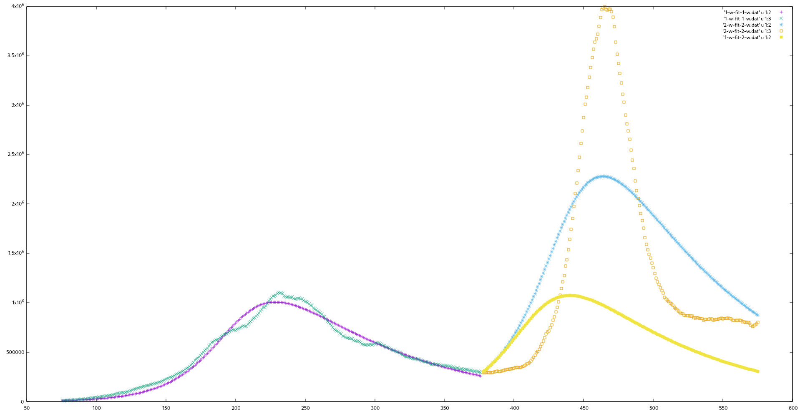

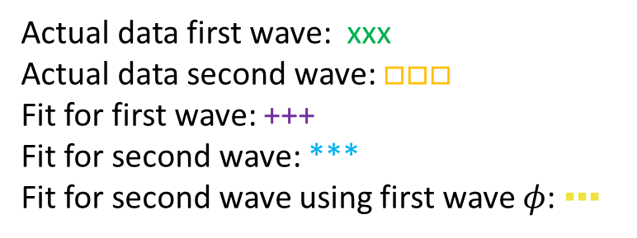
How good is this fear?
Fitting for parameters with actual data:
$$F(I)=φI^{κ}$$
Actual data first wave: xxx
Actual data second wave: $□□□$
Fit for first wave: +++
Fit for second wave: ***
Fit for second wave using first wave $φ$: ▪▪▪
Notes:
Huge assumption that waves are primarily caused by different variants. Clearly a bad assumption as waves are observed even in bacterial epidemics like plague.

Slide 12

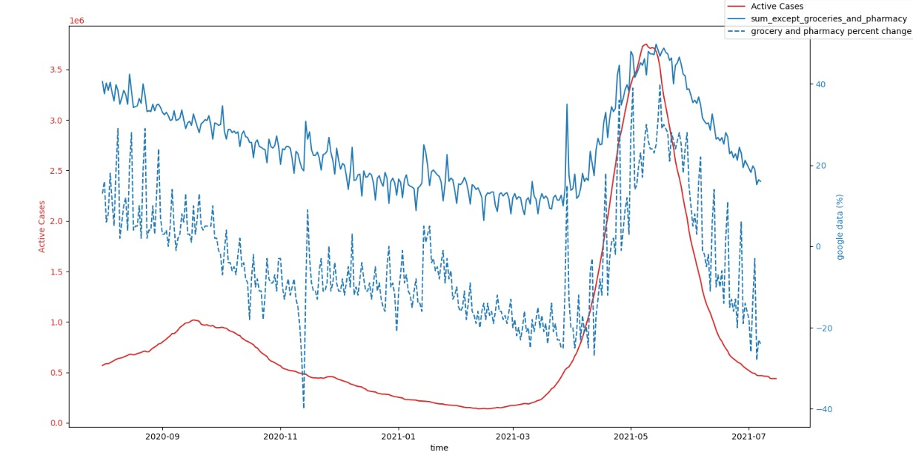
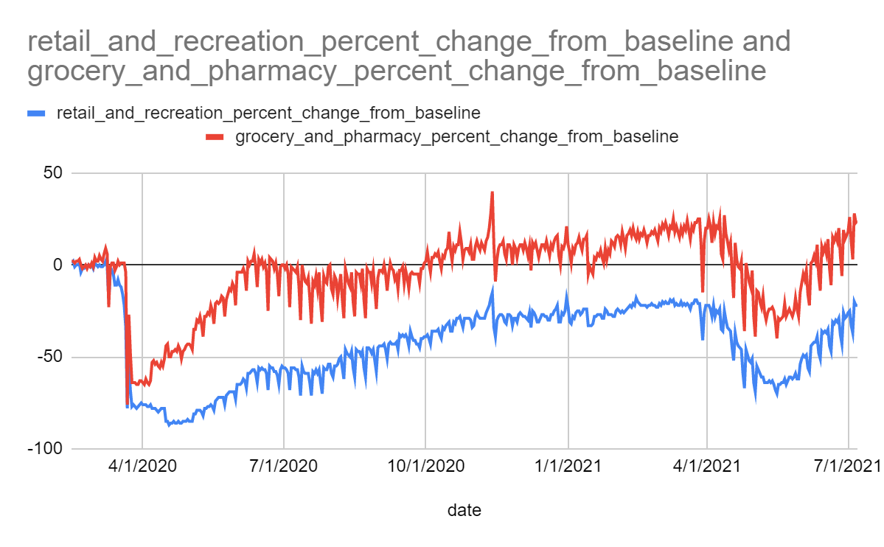
Can this be realistic?
In search of a proper fear function
Google analytics provide a way forward.
Notes:
retail_and_recreation; grocery_and_pharmacy; parks;

Slide 13
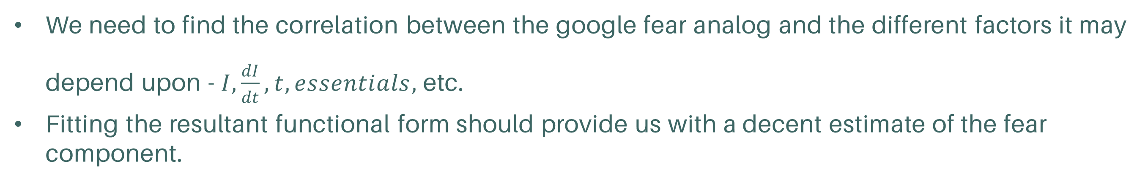
Possible future directions:
Network model
Using probability dependent step functions instead of continuous probability for hops.
Dealing with fractional population (especially relevant for pop<1).
Generalize the model to nodes having arbitrary number of neighbours.
Replicate the network map and population density for a state/country to fit the parameters.
Building a realistic fear function
We need to find the correlation between the google fear analog and the different factors it may depend upon - $I,\frac{dI}{dt}, t, essentials,$etc.
Fitting the resultant functional form should provide us with a decent estimate of the fear component.

Slide 14
Thank you!

